Slide 1
Effects of Industrial Expansion
Chapter 17 Part 4

Slide 2
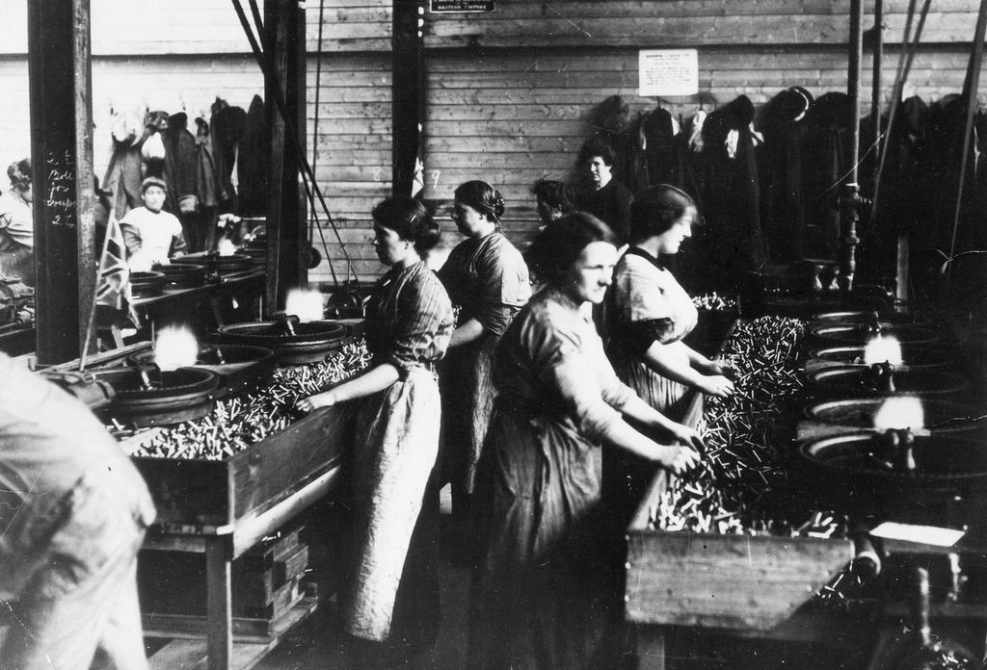
Changing American Life
American trade increasing dramatically—business boom!
City population increasing—population boom!
Problems:
Air/water pollution, overcrowding, crime—boom!
Greater focus on materialism: putting a higher value on money and possession
Benefits
More leisure time.
Labor-saving machines
More women working

Slide 3
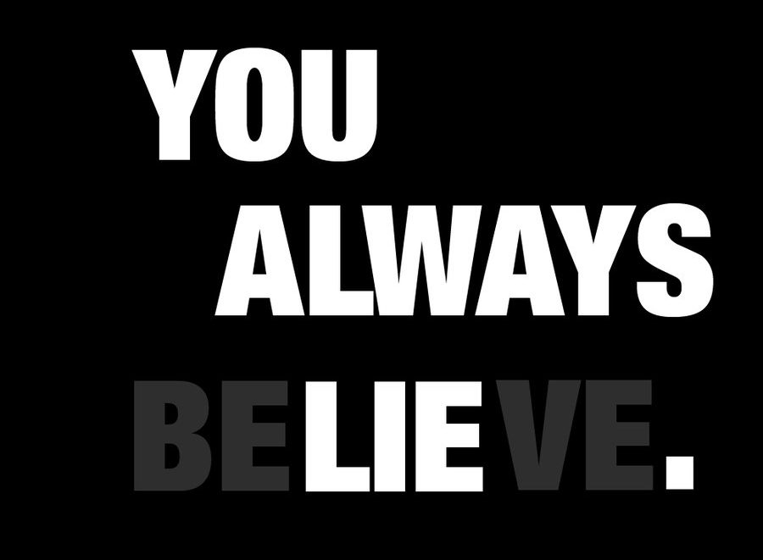
Something to Remember when Discussing Politics—or anything.
The best of lies always contains some grain of truth.

Slide 4
Capitalism
Not a perfect system. It is run by men (mankind); men (mankind) are flawed. It cannot be perfect.

Slide 5
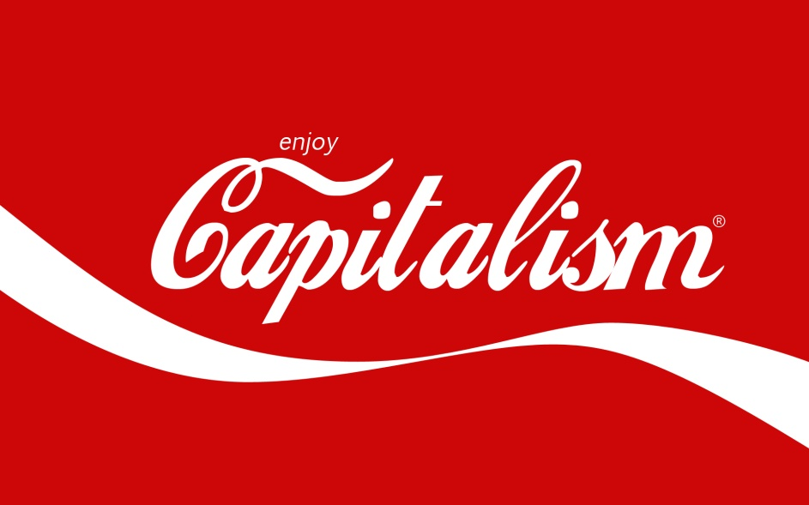
The Focus on Capitalism
Capitalism is an economic (financial) system in which people are free to invest and make profits on investments.

Slide 6
Capitalism and Social Darwinism
Social Darwinism: The application of Darwin’s theory of evolution to society.
Shows little mercy and makes little allowance for human weakness.
Mantra: Making money is the only thing that matters, no matter what the cost.

Slide 7
Laissez-Faire
Laissez-Faire (pronounced lay-say fair): an economic idea that says businesses are best left alone without any governmental regulation/interference.
Problem: Puts responsibility of taking care of the downtrodden on the government.
Result: Many Americans became fearful that America would be run by large businesses.

Slide 8
Government Regulation
Americans now relying on government to fix problems.
People have poor working conditions—form unions & sue them.

Slide 9
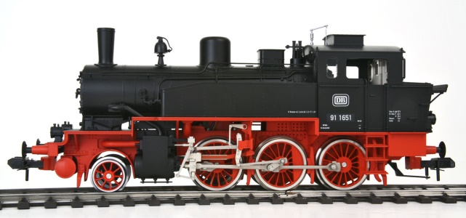
What About Dem Railroads?
Ruthless competition between railroad companies hurt small shippers, farmers, and more.
Railroads ended up charging whatever they wanted: $$$!
People demanded justice from the government.
Interstate Commerce Act
1. directed railroads to set “reasonable and just rates”
2. prevented railroads from charging more for short runs than longer ones.
3. formed the Interstate Commerce Commission—examined complaints and took offenders to court

Slide 10
The Sherman Anti-Trust Act of 1890
People suspicious of trusts
They had unfair business advantages—able offer lower prices.
Wanted to regulate trusts to prevent them from being formed: (drumroll please) The Sherman Anti-Trust Act of 1890.

Slide 11
Results of the Sherman Anti-Trust Act of 1890
Not very effective—trusts usually can find ways around the law.
Example: the holding company—gained control of companies by buying their stock. Stock = influence to be involved in any business decisions.

Slide 12
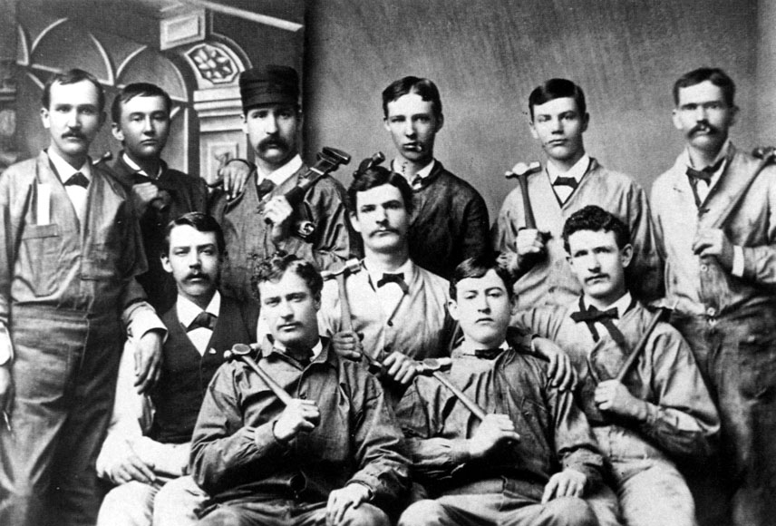
Development of Labor Unions
Industrial era led to invention of labor unions.
Wanted better wages and working conditions.
An example of a labor union: Knights of Labor.
Founded by Uriah P. Stephens
Open to all kinds of workers (men, women; skilled, unskilled laborers)

Slide 13
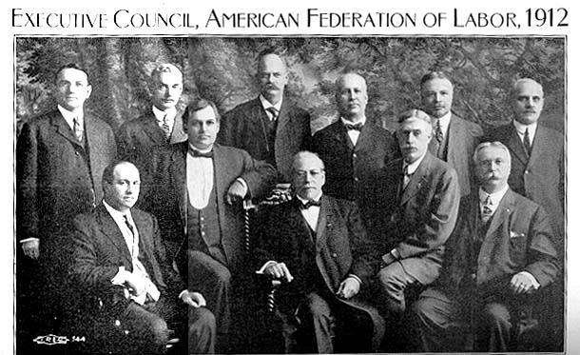
Development of Labor Unions
Example of a union: American Federation of Labor (AFL)
Founded by Samuel Gompers
A group of local unions composed of skilled laborers.
Wanted the right of collective bargaining —the right of unions to represent workers in negotiations between owners and managers. (This was a common right labor unions asked for.)

Slide 14
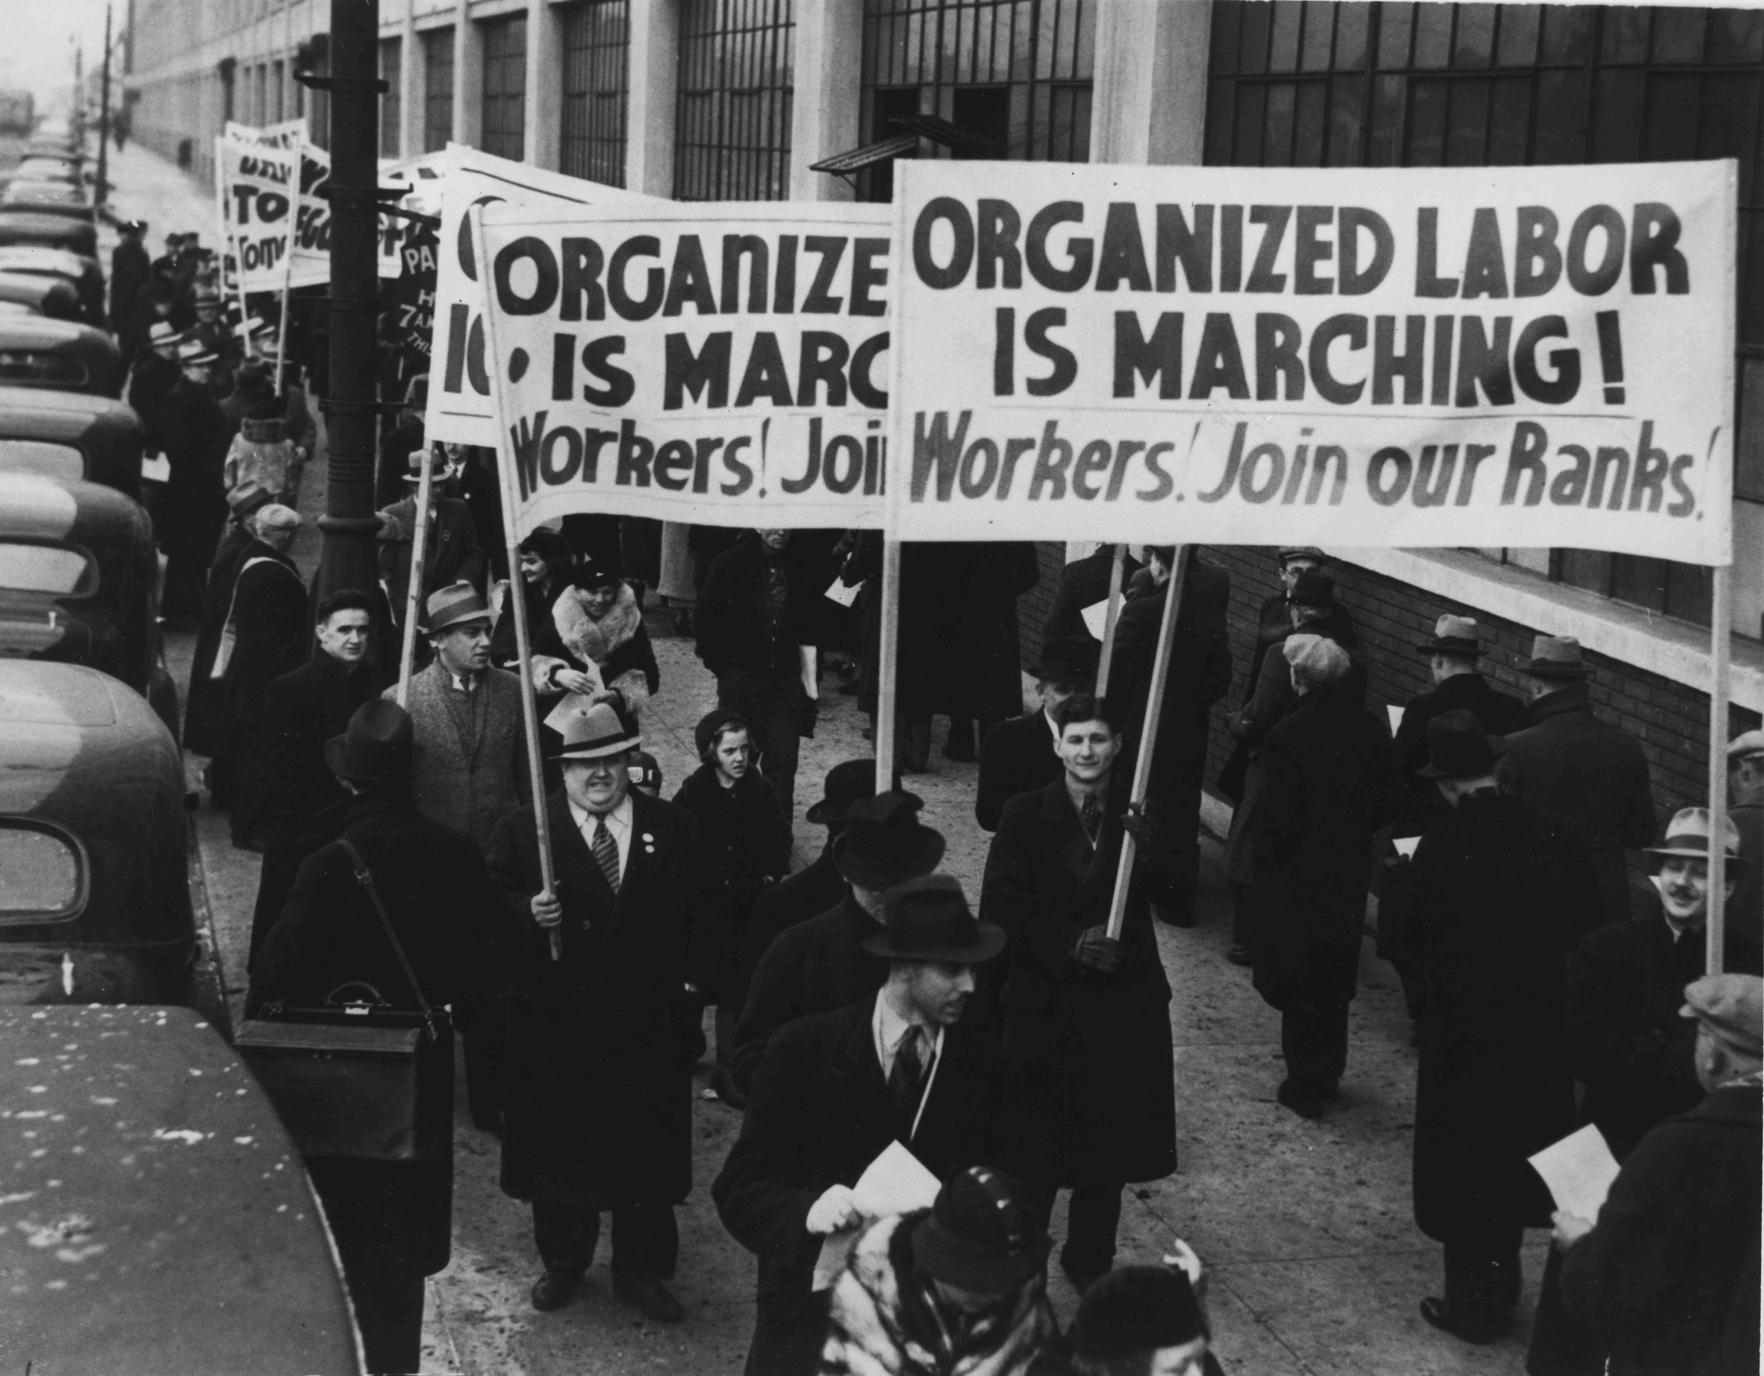
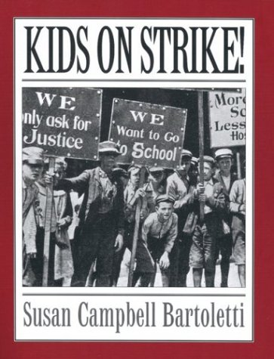
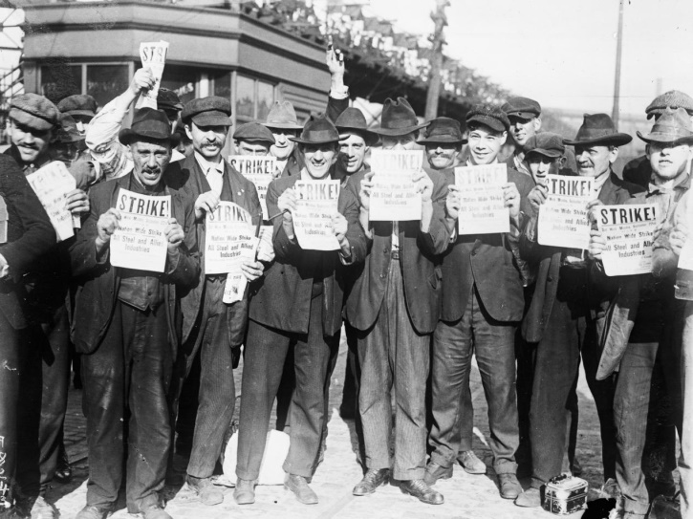
Response to Unions
Employers often opposed unions and their demands.
Unions often went on strike which hurt business.
So, how does a company stop a union strike?
Injunctions: official court orders

